Slide 1




Garbage Classification
using
Transfer learning (EfficientNetV2B2)

Slide 2

Learning Objectives
Understand the importance of waste classification in environmental sustainability.
Learn how transfer learning can be applied to image classification problems.
Gain hands-on experience using EfficientNetV2B2 with
real-world imbalanced datasets.
Explore techniques to handle data imbalance such as class
weighting and segmentation.
Build, train, and evaluate a deep learning model to achieve
high classification accuracy.
GOAL
Source :
www.freepik.com/

Slide 3
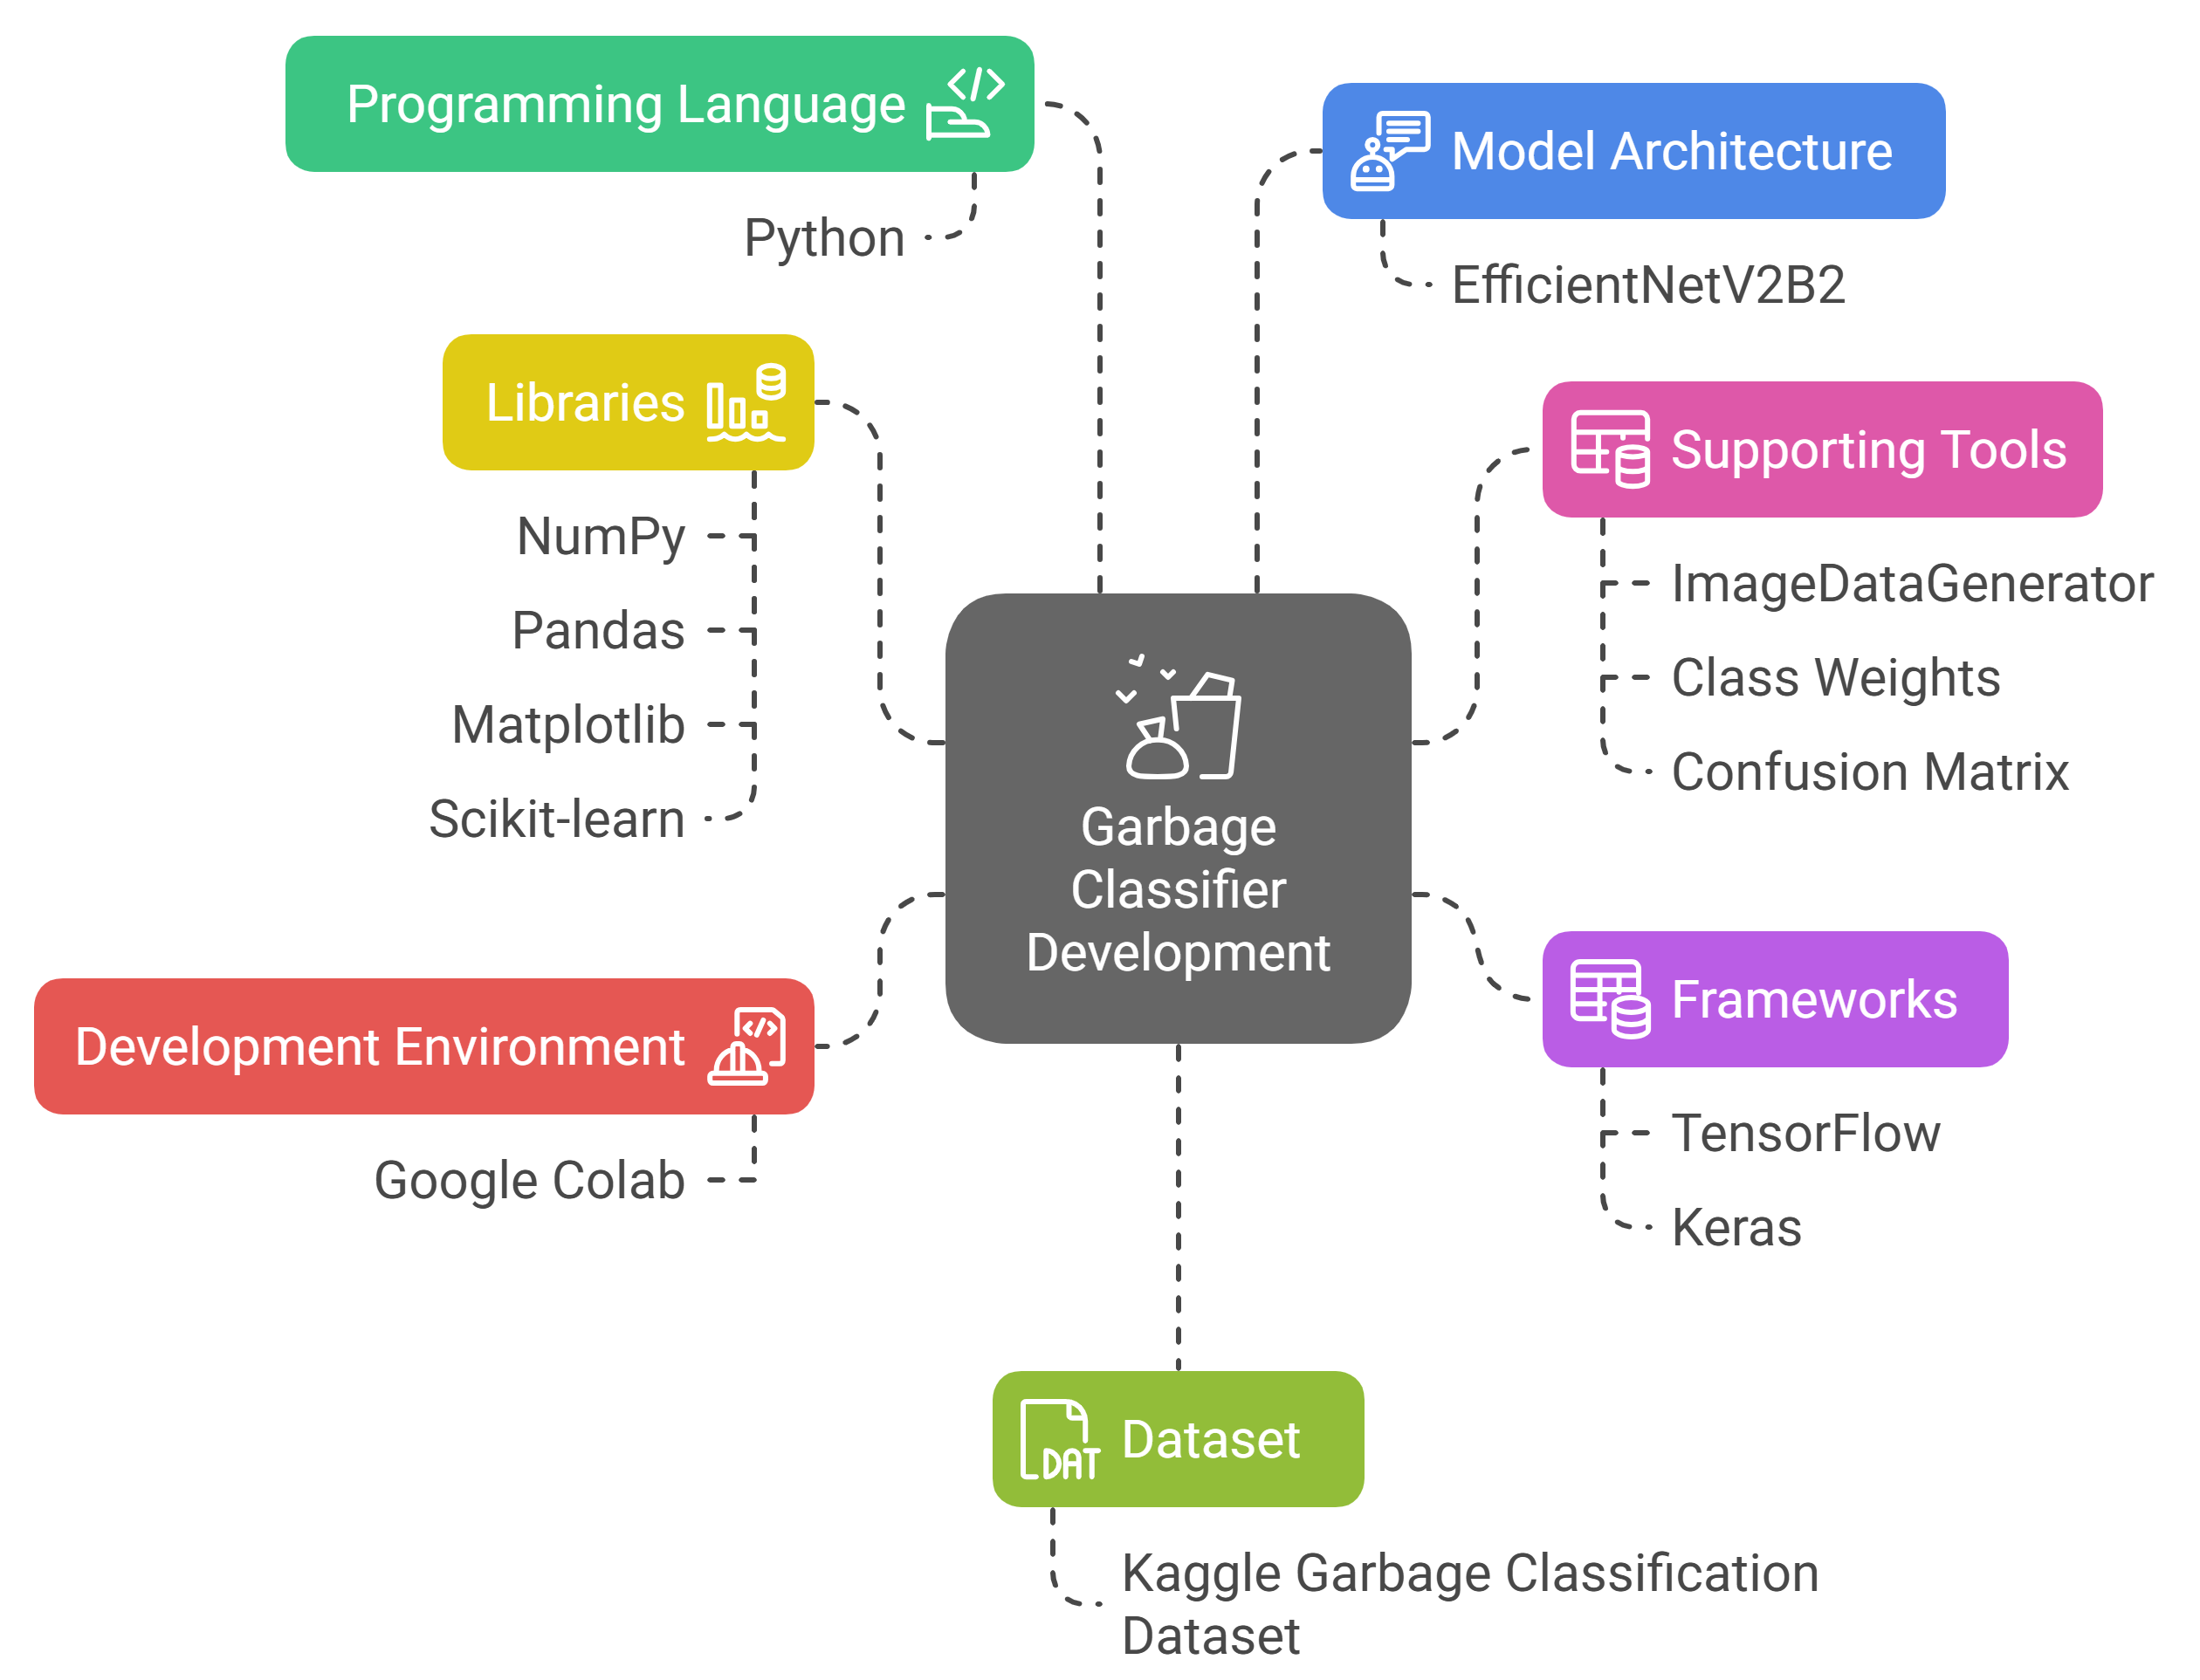
Tools and Technology used
Programming Language:
Python
Frameworks:
TensorFlow, Keras
Libraries:
NumPy, Pandas, Matplotlib, Scikit-learn
Model Architecture:
EfficientNetV2B2 (pre-trained)
Development Environment:
Google Colab
Dataset:
Kaggle Garbage Classification Dataset
Supporting Tools:
ImageDataGenerator for augmentation
Class Weights for imbalance handling
Confusion Matrix for evaluation

Slide 4
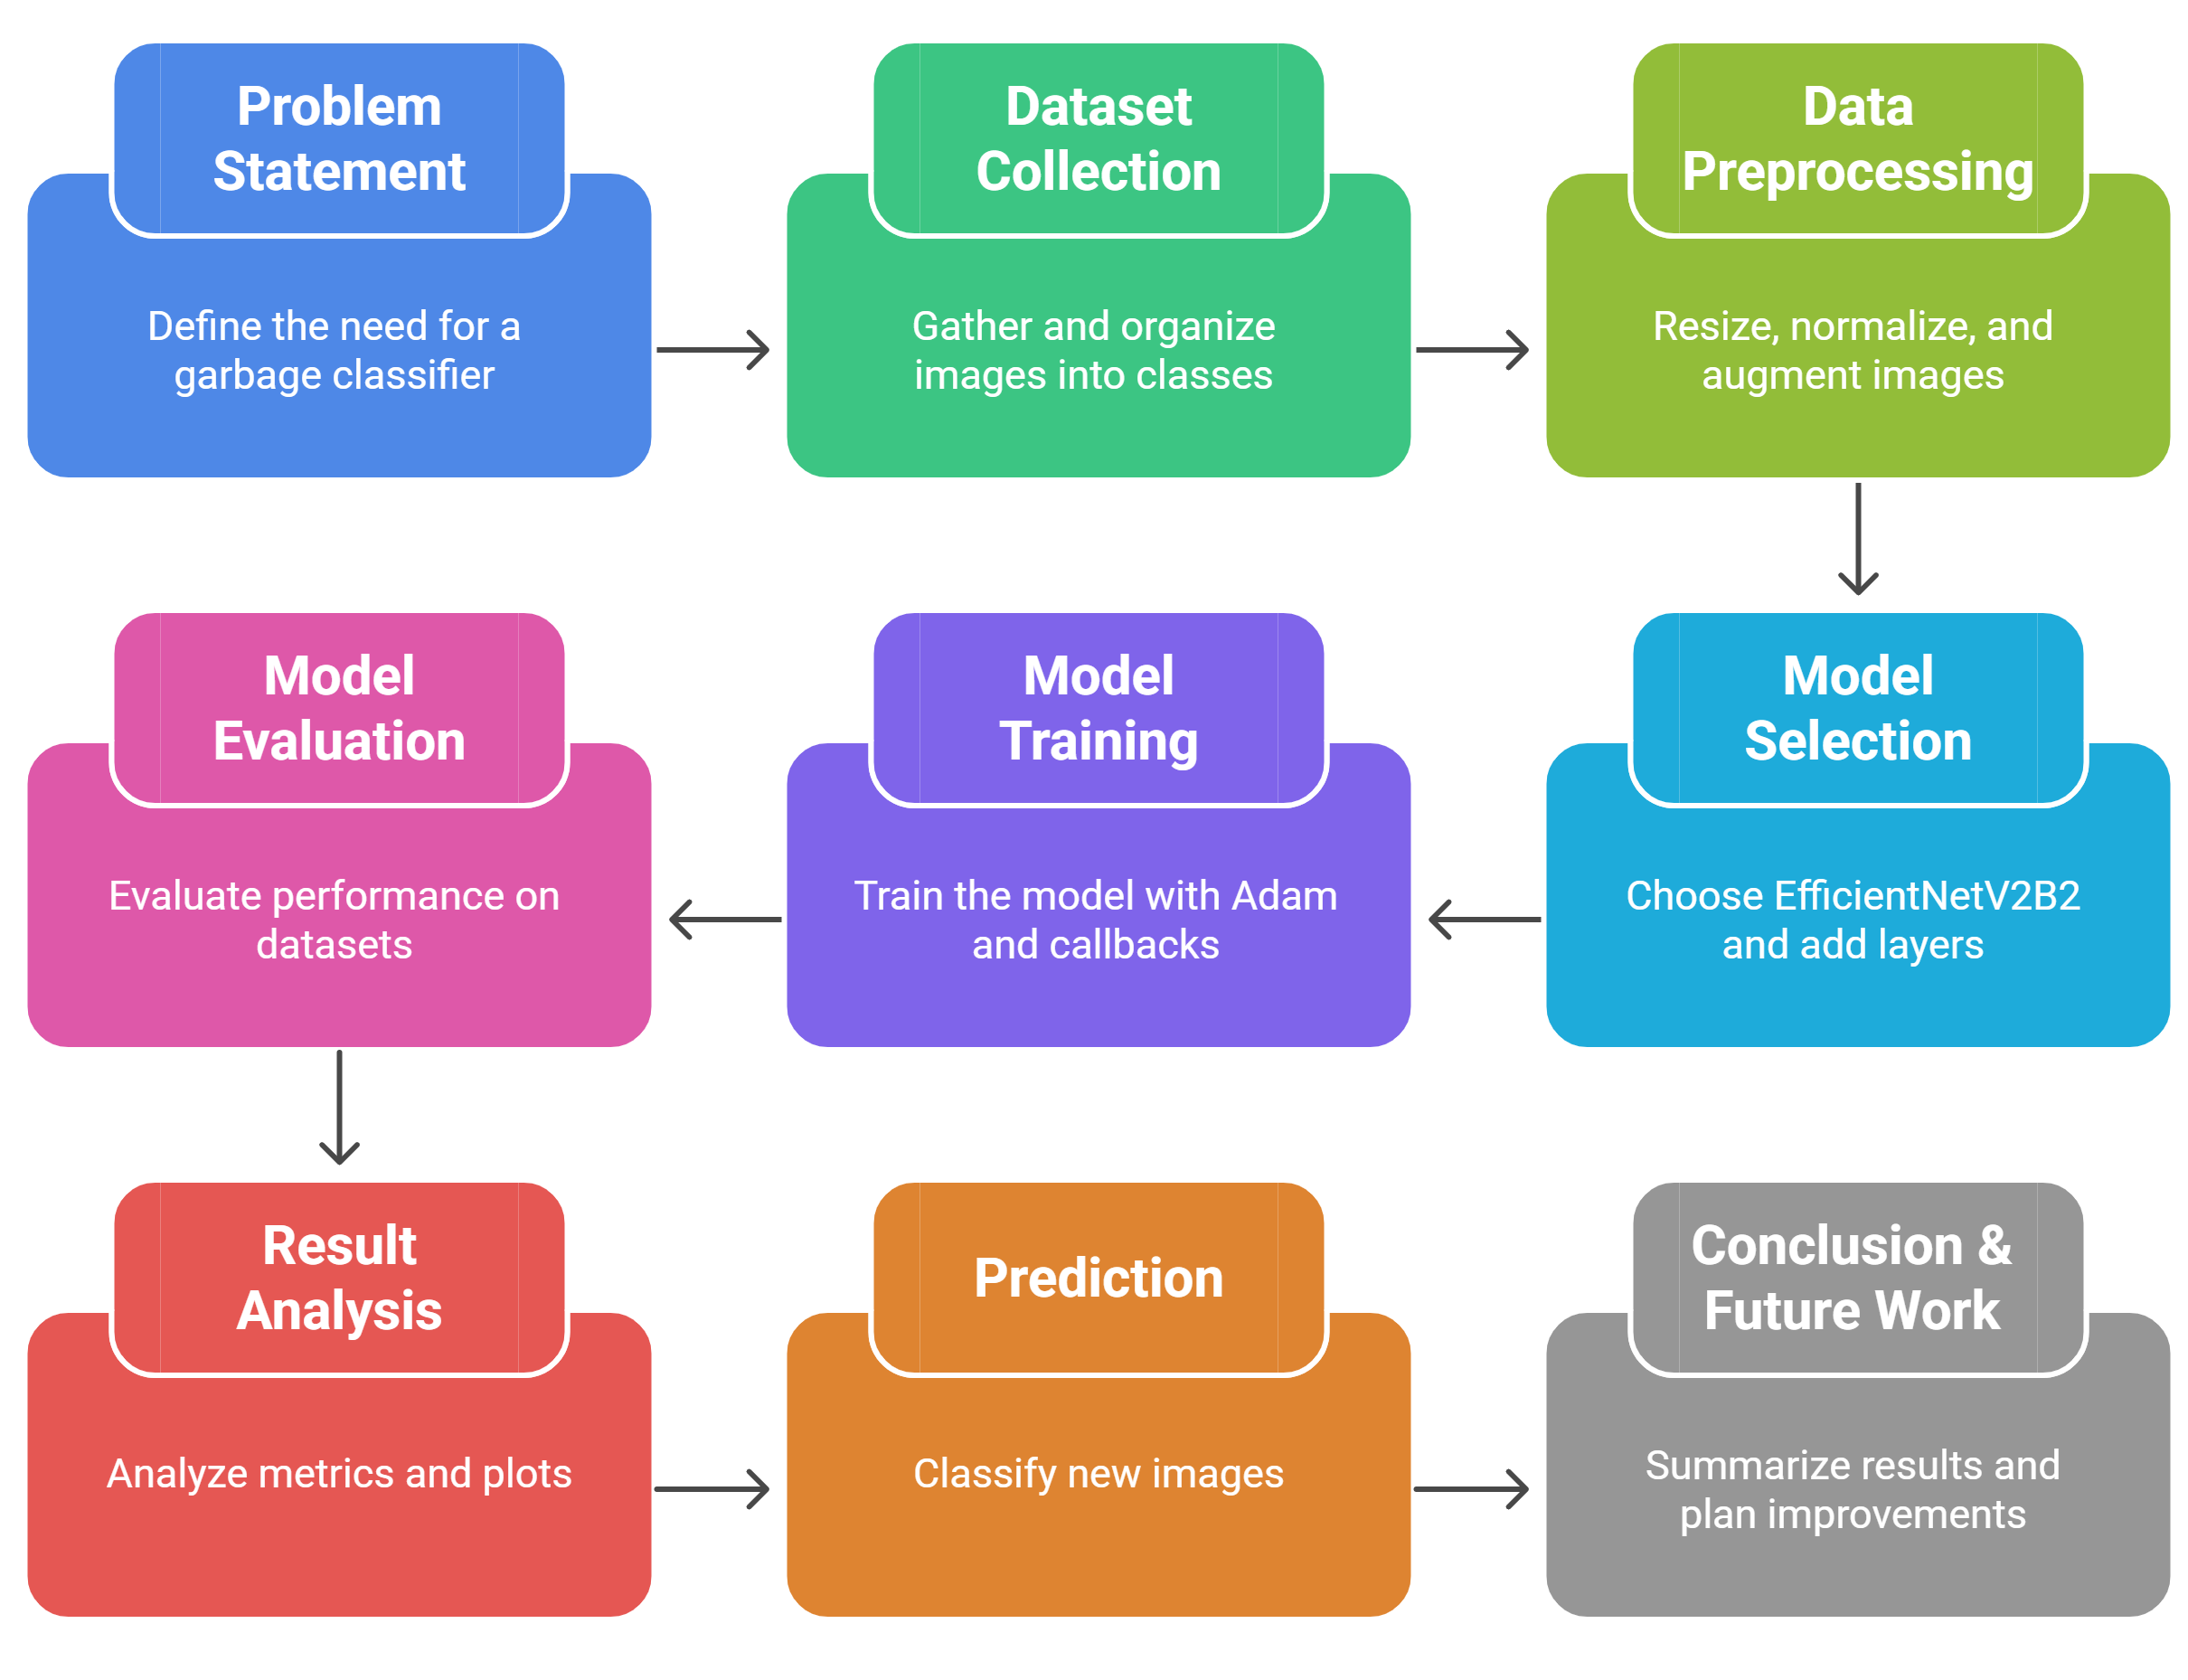
Methodology

Slide 5
Problem Statement:
Develop a sophisticated garbage classification system leveraging the EfficientNetV2B2 architecture. Our primary dataset serves as a foundation for building models that can eventually automate waste segregation, a critical step in optimizing recycling and waste management, ultimately aiding in environmental conservation.

Slide 6
Solution:
Built a deep learning classification model using EfficientNetV2B2 for garbage image classification.
Handled dataset imbalance by:
Using class weights during training
Applying data segmentation for rare classes
Increased input resolution to 224x224, boosting performance.
Achieved 94% classification accuracy on test data.
Model generalizes well and can be deployed in smart bins or waste management systems.

Slide 7
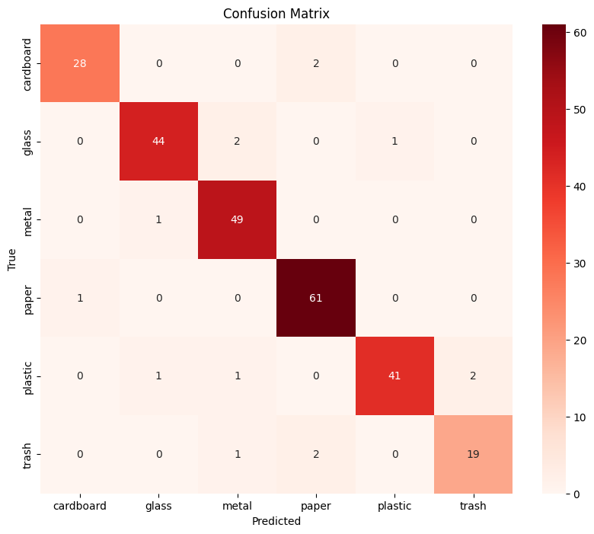
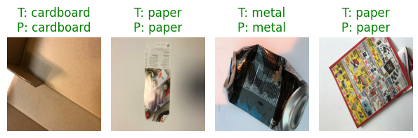
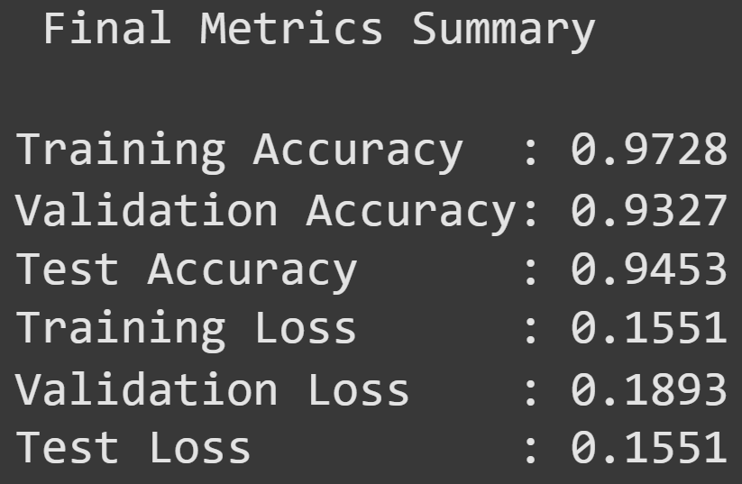
Screenshot of Output:

Slide 8
Conclusion:
Transfer learning with EfficientNetV2B2 proved to be effective and resource-efficient.
Input shape and handling imbalance played a key role in improving accuracy.
The model successfully classifies waste into appropriate categories with high accuracy.
This system can be integrated into automated waste sorting machines or mobile apps for real-time waste classification.
GitHub Repository: https://github.com/SanjayAmaravadi/AICTE-Internship.git

